Slide 1
State-of-the-art Progress on ML System
日期：2021.9.29

Slide 2
GNN Embeddings and Neural Networks (OSDI’ 21)
Dorylus: Affordable, Scalable, and Accurate GNN Training with Distributed CPU Servers and Serverless Threads
GNNAdvisor: An Adaptive and Efficient Runtime System for GNN Acceleration on GPUs
Marius: Learning Massive Graph Embeddings on a Single Machine
P3: Distributed Deep Graph Learning at Scale
Notes:
从所有可能的网络结构空间搜索最优贝叶斯结构是一个NP难题, 两种方式求得近似解:贪心算法(评价函数);限定网络结构
结构也可由专家确定;

Slide 3
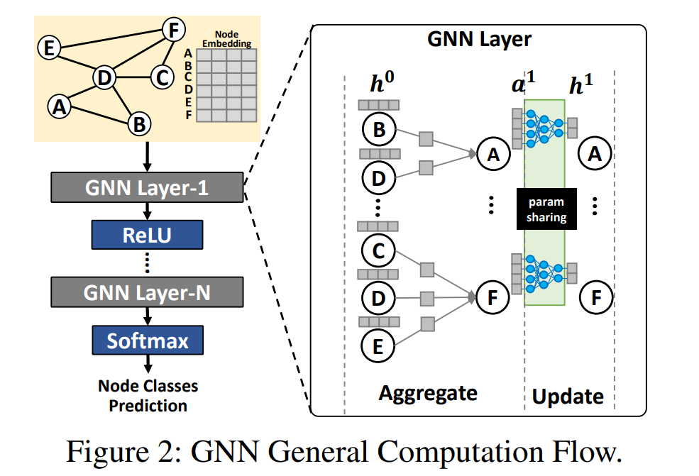
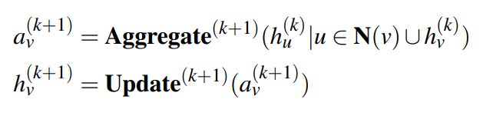
GNNAdvisor (Existing GNN Computing Frameworks)
Graph Processing Framework:
Optimizations tailored for graph algorithms.
Missing operators for NN computation.
Lack of programmability and portability.
Deep Learning Frameworks:
Focusing on programmability and generality.
Lack of efficient backend for sparse operators.
Hard-coded designs with poor input adaptability.
Notes:
从所有可能的网络结构空间搜索最优贝叶斯结构是一个NP难题, 两种方式求得近似解:贪心算法(评价函数);限定网络结构
结构也可由专家确定;

Slide 4
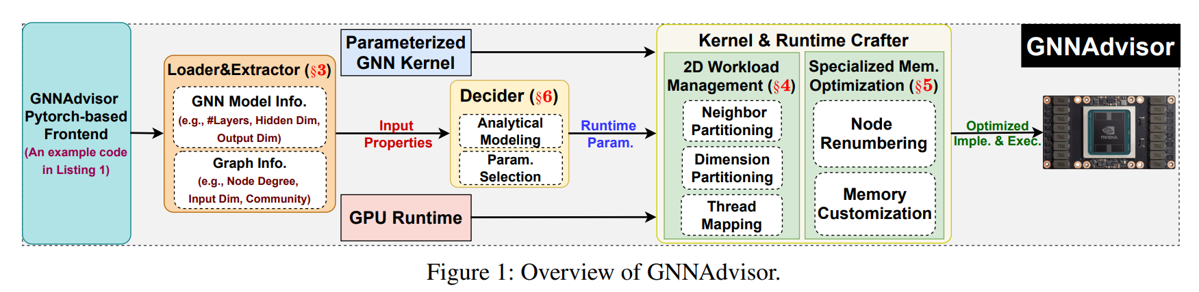
GNNAdvisor (Overview)
Input properties to guide optimization (e.g., GNN model architectures and input graphs).
An in-depth analysis of their importance in guiding system optimizations for GPU-based GNN computing.
Notes:
从所有可能的网络结构空间搜索最优贝叶斯结构是一个NP难题, 两种方式求得近似解:贪心算法(评价函数);限定网络结构
结构也可由专家确定;

Slide 5
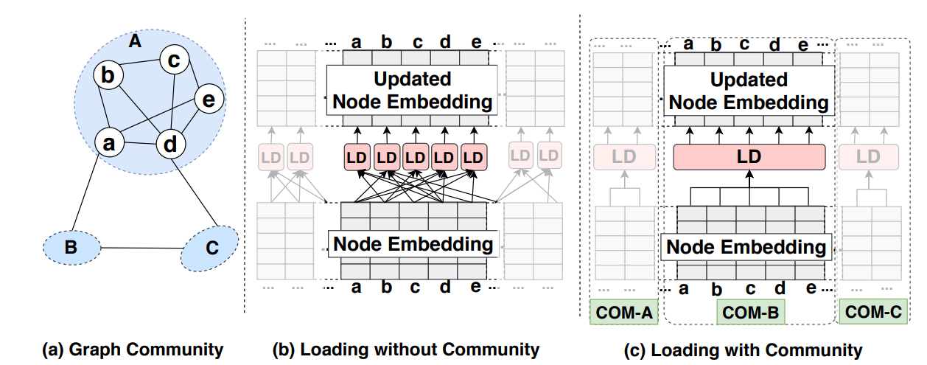
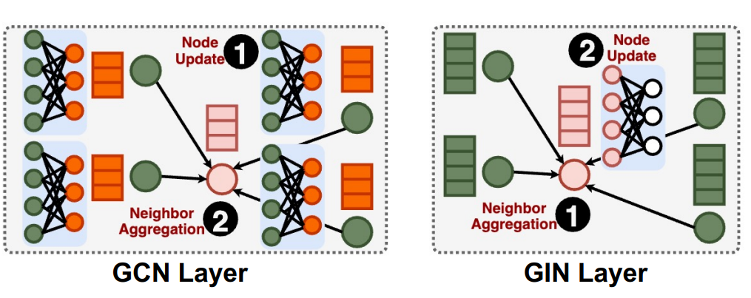
GNNAdvisor (Analysis of Input Information)
Graph & GNN Model Information
Node Degree : Real-world graphs follow the powerlaw distribution of node degrees.
Embedding Dimensionality : GNN input graphs demonstrates various node embedding size.
Graph community : Skewed edge distribution widely exists many real-world graphs.
Type of Aggregation : GCN would prefer more memory optimization on the small node embeddings while GIN would prefer more computing parallelism on the large node embeddings.
Notes:
从所有可能的网络结构空间搜索最优贝叶斯结构是一个NP难题, 两种方式求得近似解:贪心算法(评价函数);限定网络结构
结构也可由专家确定;

Slide 6
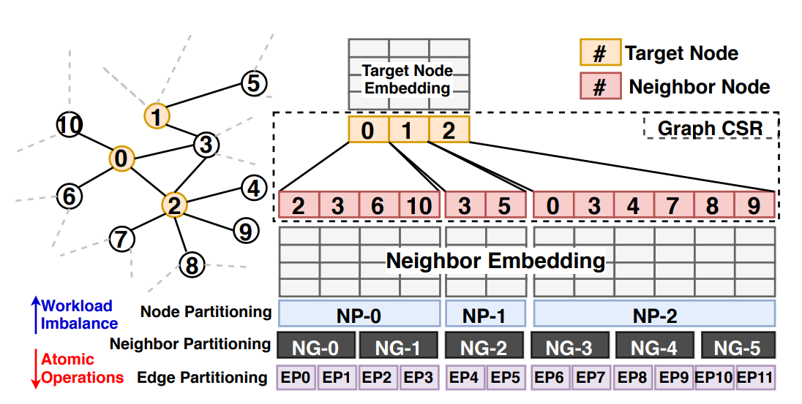
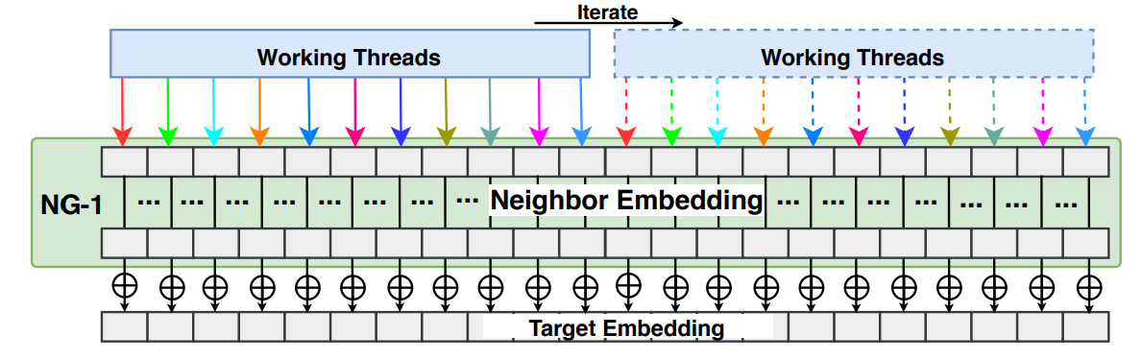
GNNAdvisor (2D Worklaod Management)
Workload : the number of neighbors, the size of the embedding dimension
GNNAdvisor incorporates an inputdriven parameterized 2D workload management tailored for GNNs, including three techniques:
coarse-grained neighbor partitioning
fine-grained dimension partitioning
warpbased thread alignment
Notes:
从所有可能的网络结构空间搜索最优贝叶斯结构是一个NP难题, 两种方式求得近似解:贪心算法(评价函数);限定网络结构
结构也可由专家确定;

Slide 7
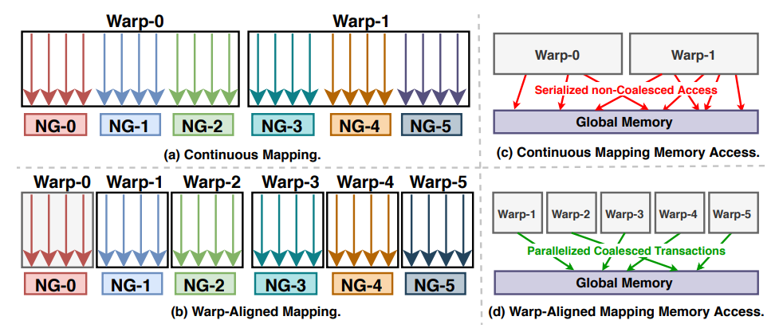
GNNAdvisor (2D Worklaod Management)
Workload : the number of neighbors, the size of the embedding dimension
GNNAdvisor incorporates an inputdriven parameterized 2D workload management tailored for GNNs, including three techniques:
coarse-grained neighbor partitioning
fine-grained dimension partitioning
warpbased thread alignment
Notes:
从所有可能的网络结构空间搜索最优贝叶斯结构是一个NP难题, 两种方式求得近似解:贪心算法(评价函数);限定网络结构
结构也可由专家确定;

Slide 8
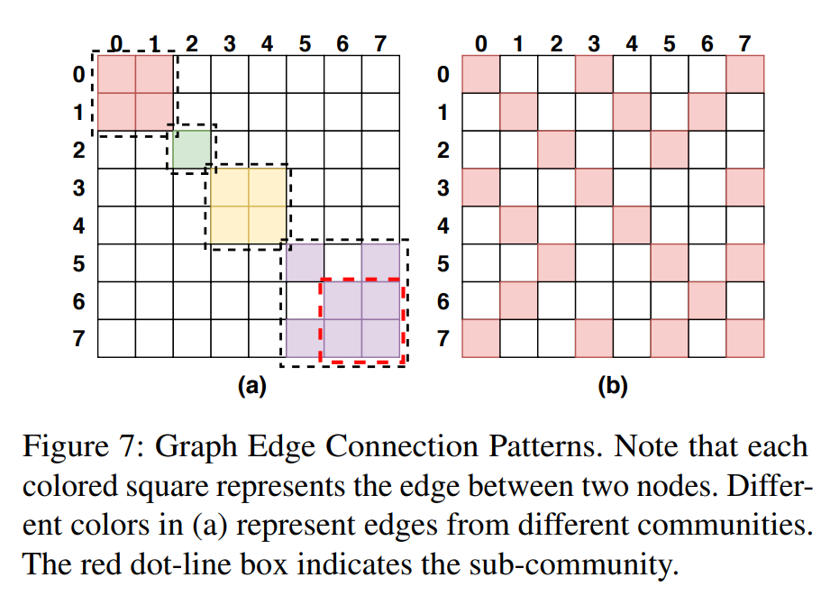
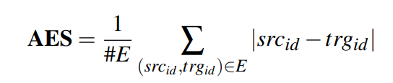
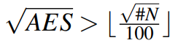
GNNAdvisor (GNN-specialized Memory Optimizations)
Community-aware Node Renumbering
When to apply :
How to apply : Rabbit Reordering
Notes:
从所有可能的网络结构空间搜索最优贝叶斯结构是一个NP难题, 两种方式求得近似解:贪心算法(评价函数);限定网络结构
结构也可由专家确定;

Slide 9
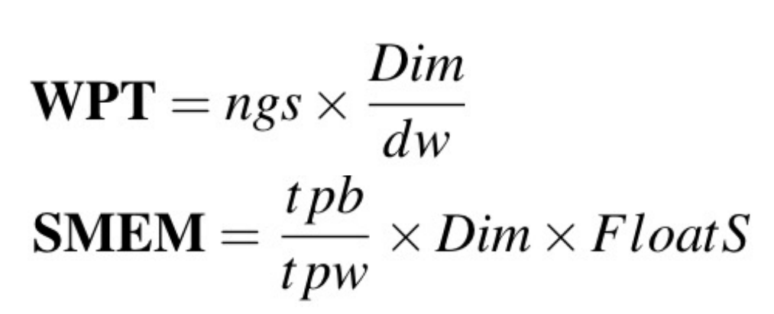
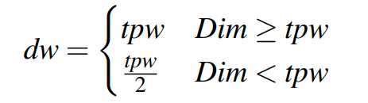
GNNAdvisor (Design Optimization)
Analytical Modeling:
The performance/resource analytical model of GNNAdvisor has two variables, workload per thread (WPT), and shared memory usage per block (SMEM).
Parameter Auto Selection:
To determine the value of the neighbor-group size (ngs) and dimension-worker (dw), we follow two steps.
First, we determine the value of dw based on tpw (thread-per-warp) and dim (embedding dimension).
Second, we determine the value of ngs based on the selected dw and the thread-per-block (tpb).
Notes:
从所有可能的网络结构空间搜索最优贝叶斯结构是一个NP难题, 两种方式求得近似解:贪心算法(评价函数);限定网络结构
结构也可由专家确定;

Slide 10
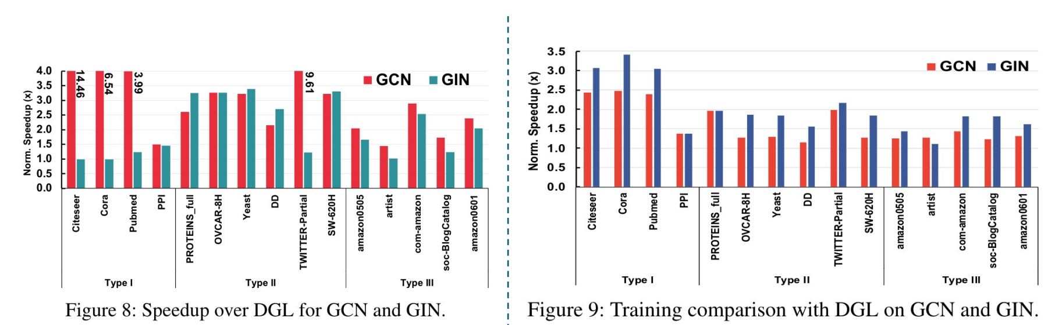
GNNAdvisor (Evaluation)
Notes:
从所有可能的网络结构空间搜索最优贝叶斯结构是一个NP难题, 两种方式求得近似解:贪心算法(评价函数);限定网络结构
结构也可由专家确定;

Slide 11
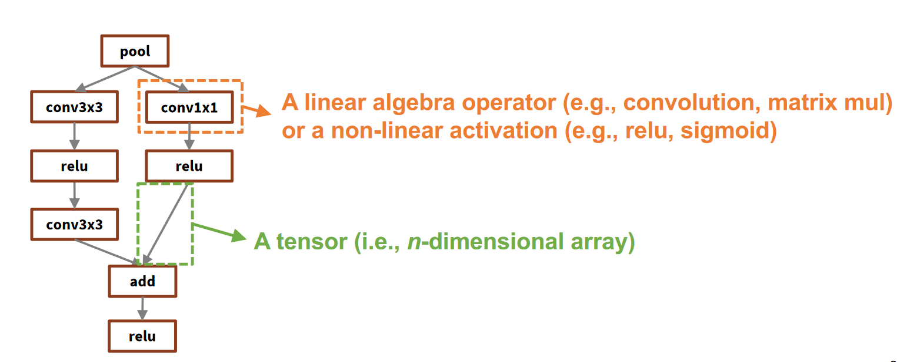
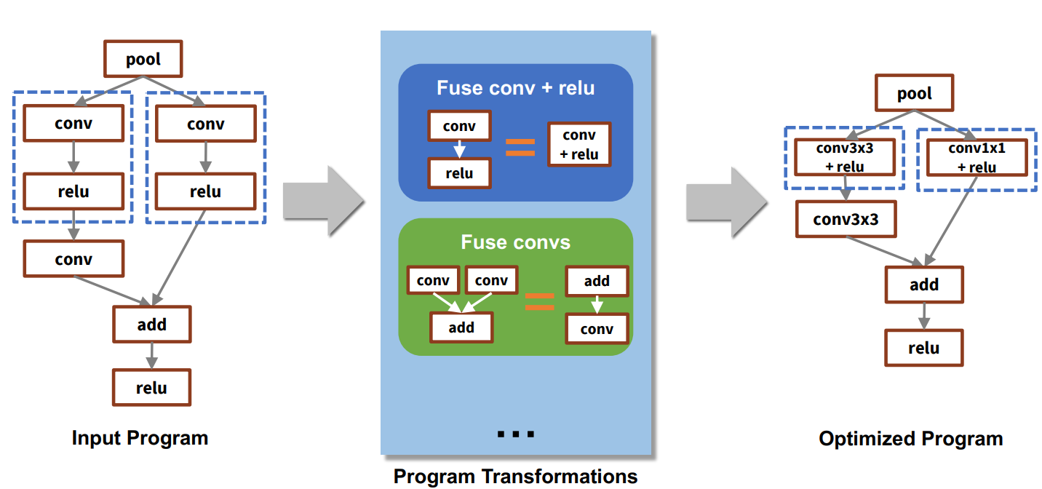
PET
PET: Optimizing Tensor Programs with Partially Equivalent Transformations and Automated Corrections
Fully Equivalent Transformations:
Pro : preserve functionality.
Con : miss optimization.
Partially Equivalent Transformations:
Pro : faster ML operators
Con : potential accuracy loss.
Is it possible to exploit partially equivalent transformations to improve performance while preserving equivalence?
Notes:
从所有可能的网络结构空间搜索最优贝叶斯结构是一个NP难题, 两种方式求得近似解:贪心算法(评价函数);限定网络结构
结构也可由专家确定;

Slide 12
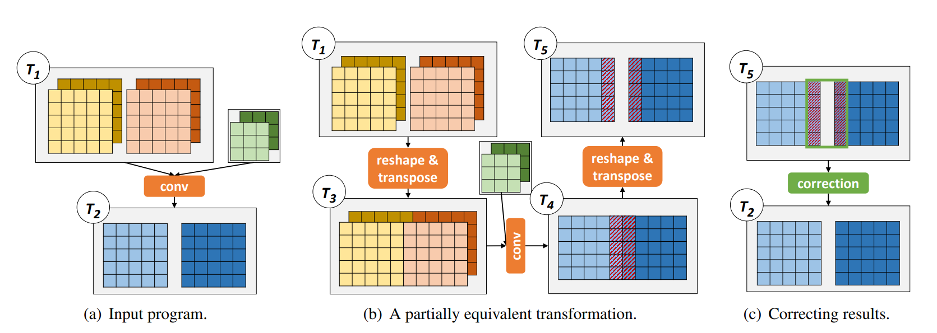
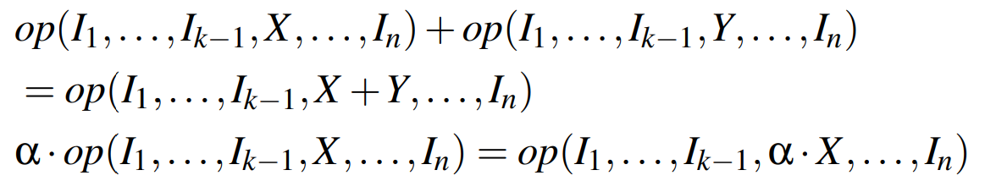
PET (Motivation)
Key Idea : partially equivalent transformations for multi-linear tensor programs(MLTP)
DNN computation = MLTP + non-linear activations
Notes:
从所有可能的网络结构空间搜索最优贝叶斯结构是一个NP难题, 两种方式求得近似解:贪心算法(评价函数);限定网络结构
结构也可由专家确定;

Slide 13
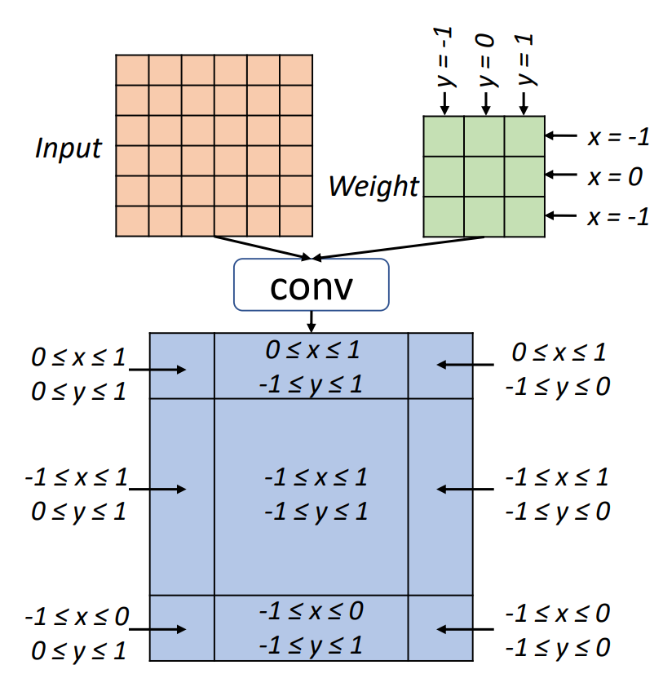
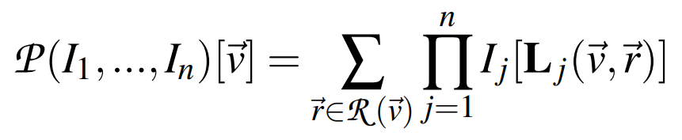
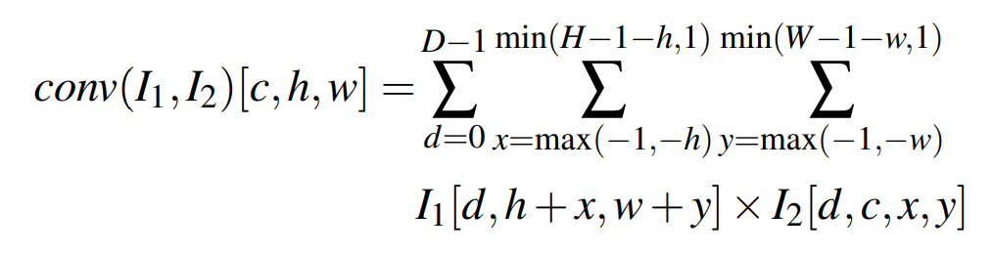
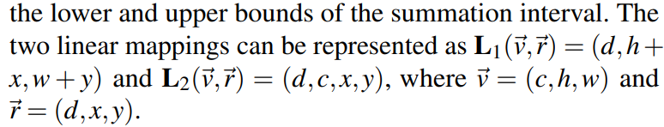
PET (Math Proof)
Notes:
从所有可能的网络结构空间搜索最优贝叶斯结构是一个NP难题, 两种方式求得近似解:贪心算法(评价函数);限定网络结构
结构也可由专家确定;

Slide 14
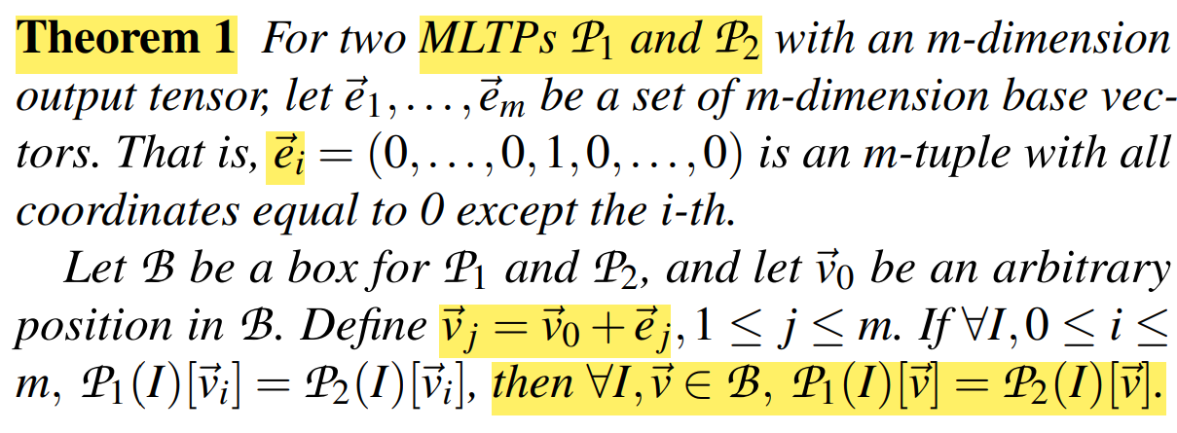
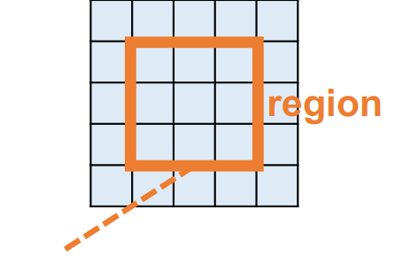
PET (Math Proof)
Notes:
从所有可能的网络结构空间搜索最优贝叶斯结构是一个NP难题, 两种方式求得近似解:贪心算法(评价函数);限定网络结构
结构也可由专家确定;

Slide 15
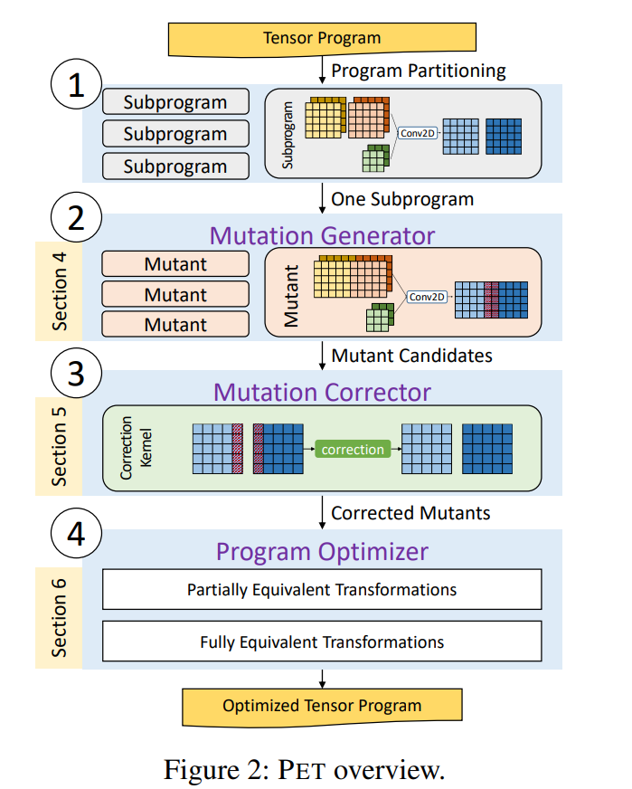
PET (Overview)
Mutation Generator
construct potential program mutants.
Mutation Corrector
examines the equivalence between an input subprogram and its mutant and automatically generates correction kernels.
Program Optimizer
apply a series of post-optimizations across the subprogram boundaries, including redundancy elimination and operator fusion.
Notes:
从所有可能的网络结构空间搜索最优贝叶斯结构是一个NP难题, 两种方式求得近似解:贪心算法(评价函数);限定网络结构
结构也可由专家确定;

Slide 16
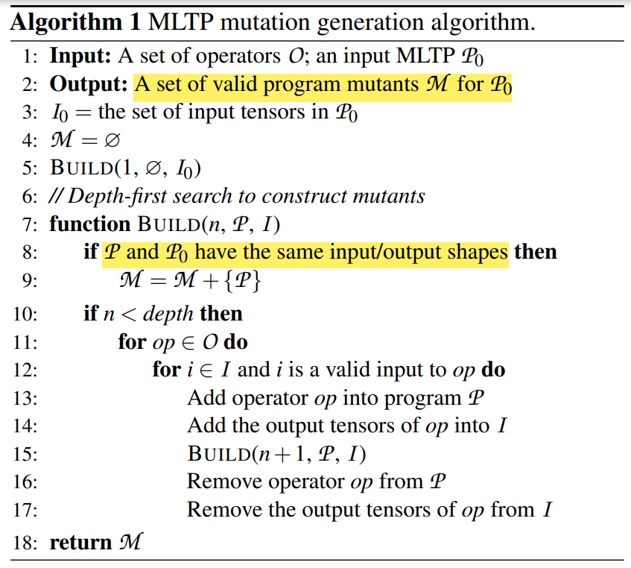
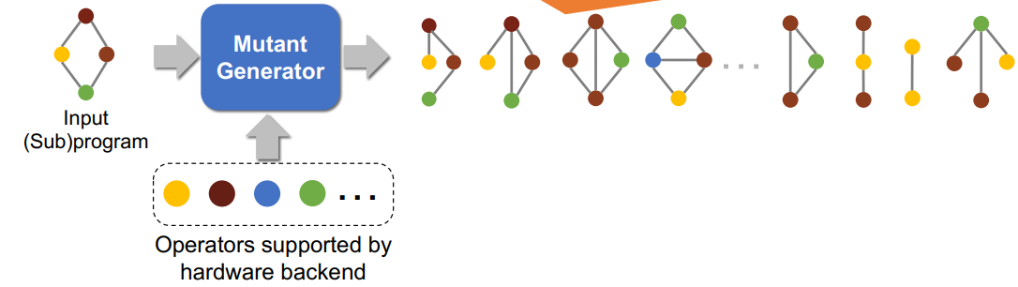
PET (Mutation Generator)
Each generated mutant does not necessarily preserve mathematical equivalence to the input program on the entire output tensors
Notes:
从所有可能的网络结构空间搜索最优贝叶斯结构是一个NP难题, 两种方式求得近似解:贪心算法(评价函数);限定网络结构
结构也可由专家确定;

Slide 17
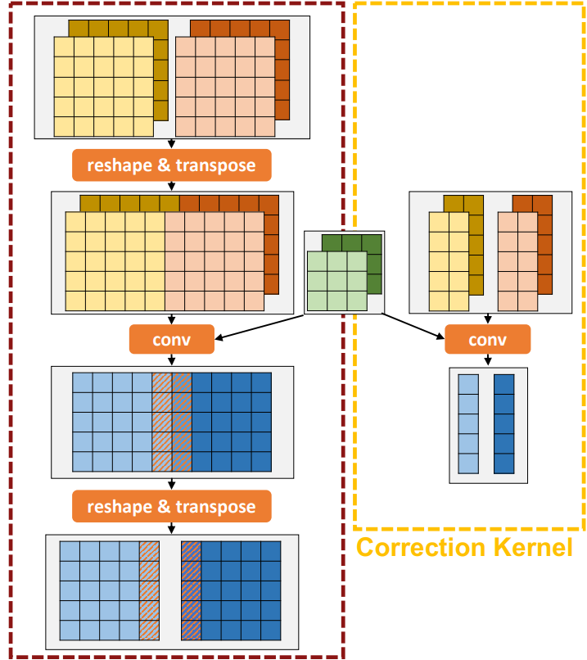
PET (Mutation Corrector)
Step 1: Box propagation
Step 2: Random testing for each box pai
Step 3: Correction kernel generation
Notes:
从所有可能的网络结构空间搜索最优贝叶斯结构是一个NP难题, 两种方式求得近似解:贪心算法(评价函数);限定网络结构
结构也可由专家确定;

Slide 18
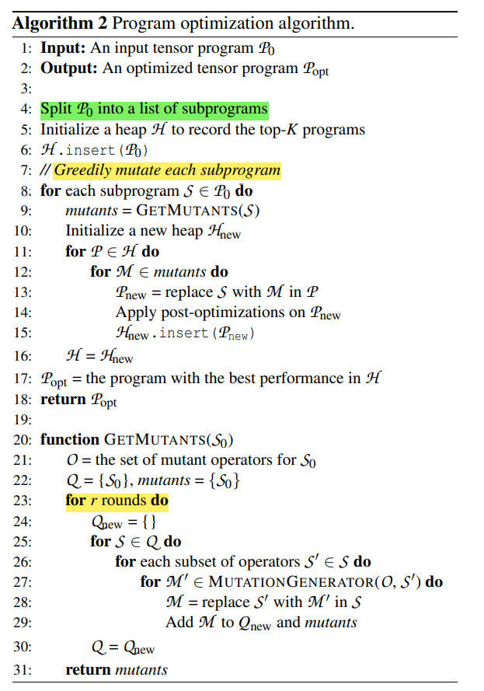
PET (Program Optimizer)
Program Splitting
How to split the program into subprograms and preserve its most program optimization opportunities?
We use non-linear operators in tensor programs as the split points.
Except for fusion, most existing tensor program transformations do not include non-linear operators.
Subprogram Optimization
Post-Optimizations
Inverses elimination
Operator fusion
Preprocessing
Top-k best performace candidates
Notes:
从所有可能的网络结构空间搜索最优贝叶斯结构是一个NP难题, 两种方式求得近似解:贪心算法(评价函数);限定网络结构
结构也可由专家确定;

Slide 19
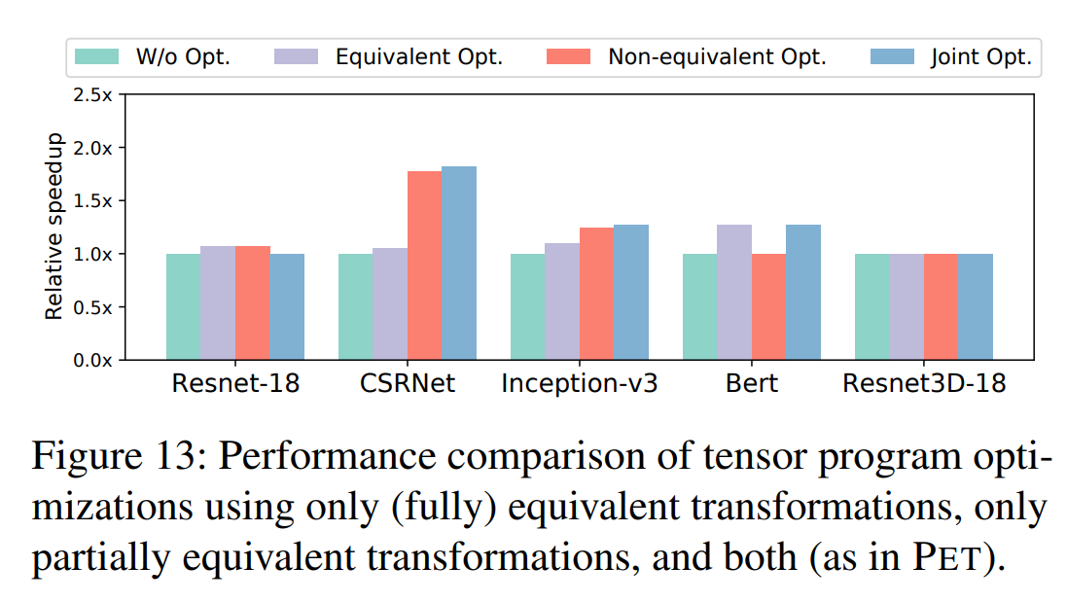
PET (Evaluation)
Notes:
从所有可能的网络结构空间搜索最优贝叶斯结构是一个NP难题, 两种方式求得近似解:贪心算法(评价函数);限定网络结构
结构也可由专家确定;

Slide 20
Tuna
Tuna: A Static Analysis Approach to Optimizing Deep Neural Networks
Method Based on Auto-tuning:
AutoTVM, Ansor, FlexTensor, Halide auto-scheduler.
It requires collecting profile data from the execution of entire DNN on a real device.
Time of auto-tuning is prohibitively long. Tuning TensorFlow SSD MobileNet for Amazon Graviton2 target with AutoTVM takes 240 hours.
Vendor-supplied Kernel Libraries:
Vendor libraries don’t cover every operation.
Adding more kernels requires heavy engineering effort.
One vendor library usually only supports a specific hardware architecture.
Notes:
从所有可能的网络结构空间搜索最优贝叶斯结构是一个NP难题, 两种方式求得近似解:贪心算法(评价函数);限定网络结构
结构也可由专家确定;

Slide 21
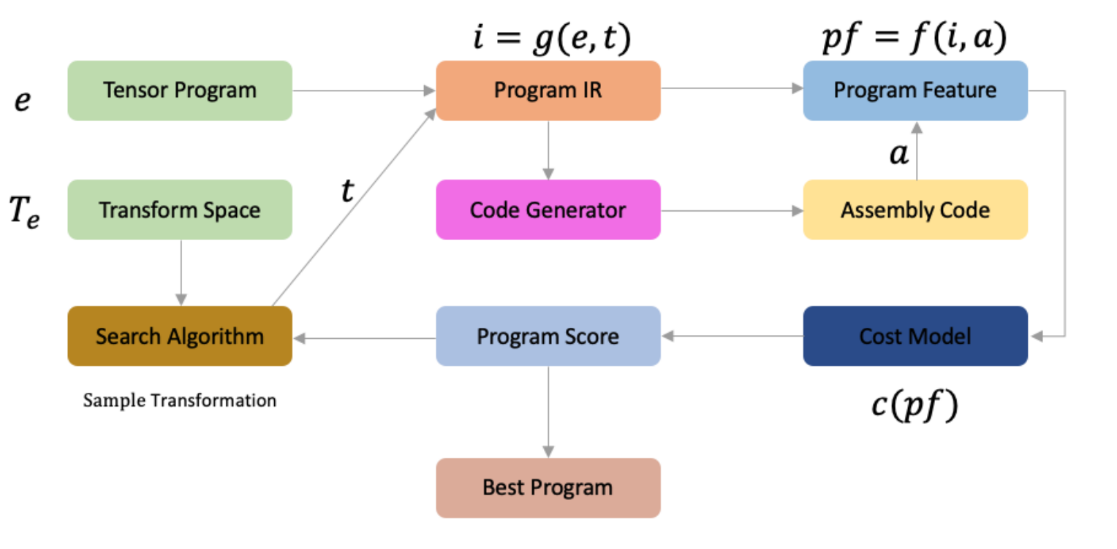
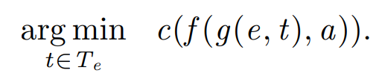
Tuna (Overview)
Optimization is done with static analysis and no real hardware is required.
Only one single cost model is required for one major architecture, such as CPU and GPU.
Multi-threaded search algorithm : evolution strategy
Hardware related cost model : target hardware related features, such as number of SIMD instructions, CPU cache locality, GPU shared memory utilization, etc.
Notes:
从所有可能的网络结构空间搜索最优贝叶斯结构是一个NP难题, 两种方式求得近似解:贪心算法(评价函数);限定网络结构
结构也可由专家确定;

Slide 22
Tuna (CPU Cost Model)
Number of SIMD instructions
Estimation of L1 cache miss
Instruction level parallelism
Notes:
从所有可能的网络结构空间搜索最优贝叶斯结构是一个NP难题, 两种方式求得近似解:贪心算法(评价函数);限定网络结构
结构也可由专家确定;

Slide 23
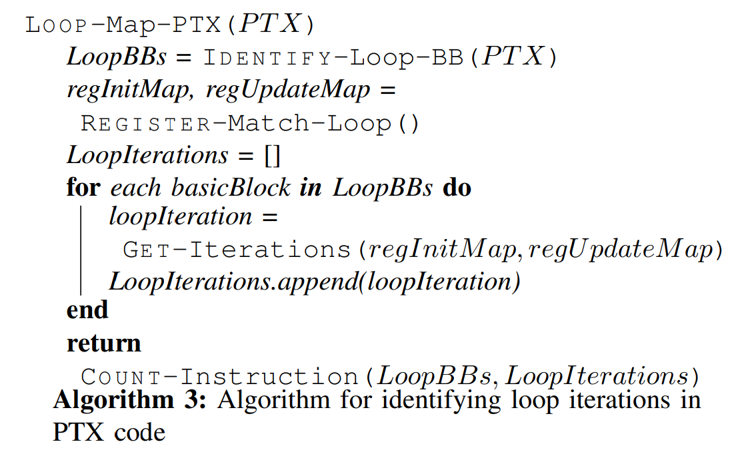
Tuna (Nvidia GPU Cost Model)
Number of PTX instructions ：parse the Nvidia GPU PTX code
Thread level parallelism ：We evaluate several aspects that directly affect GPU threadlevel parallelism: number of operations in a single thread, Streaming Multiprocessor (SM) occupancy, warp latency hiding and shared memory bank conflict.
Workload per thread
Streaming Multiprocessor (SM) occupancy
Warp latency hiding
Shared memory bank conflict
Notes:
从所有可能的网络结构空间搜索最优贝叶斯结构是一个NP难题, 两种方式求得近似解:贪心算法(评价函数);限定网络结构
结构也可由专家确定;

Slide 24
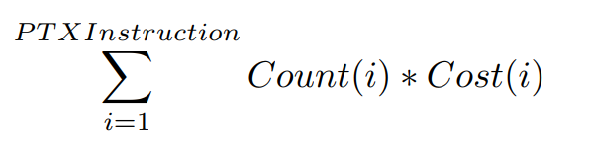
Tuna (Nvidia GPU Cost Model)
Workload per thread
The workload per thread is represented by the total number of cycles.
Streaming Multiprocessor (SM) occupancy
We check the total number of thread blocks to determine whether it is greater than the total number of SMs, so that all SMs have at least one block to execute.
Warp latency hiding
With more warps on each SM, GPU warp scheduler has a better chance to hide memory latency, thus achieving better performance.
These information can be extracted with nvcc ptxas-option command.
Notes:
从所有可能的网络结构空间搜索最优贝叶斯结构是一个NP难题, 两种方式求得近似解:贪心算法(评价函数);限定网络结构
结构也可由专家确定;

Slide 25
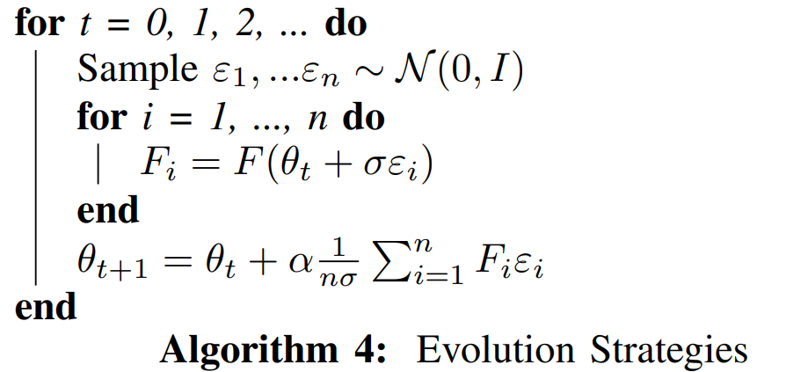
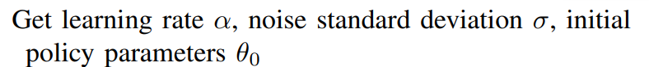
Tuna (Search Algorithm)
Notes:
从所有可能的网络结构空间搜索最优贝叶斯结构是一个NP难题, 两种方式求得近似解:贪心算法(评价函数);限定网络结构
结构也可由专家确定;

Slide 26
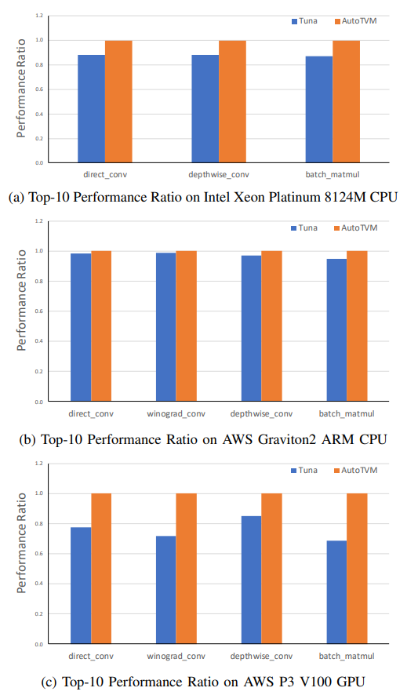
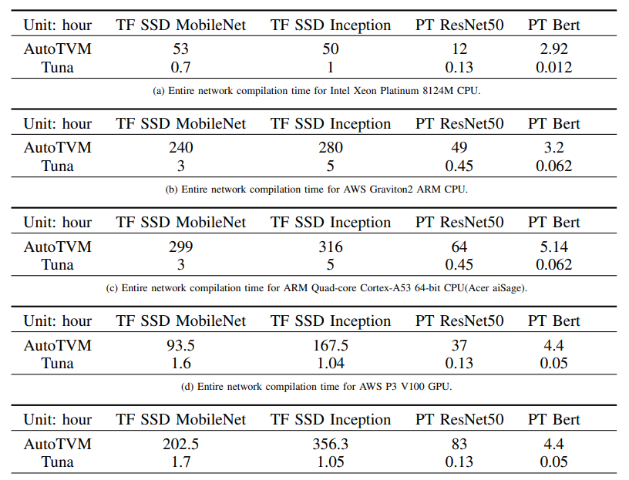
Tuna (Evaluation)
动态图编译优化的难点：每次对于不同尺寸的input,都需要临时通过runtime进行编译优化。
对算子在不同target上的cost model进行建模可以大大缩短编译优化时间。
Notes:
从所有可能的网络结构空间搜索最优贝叶斯结构是一个NP难题, 两种方式求得近似解:贪心算法(评价函数);限定网络结构
结构也可由专家确定;

Slide 27
Thanks for watching!
日期：2021.9.329

